Slide 1
Lighthouse Labs Project
Machine Learning | Clustering and Principal Component Analysis
By:
Sebastien Garneau
Josh Ho

Slide 2
Agenda
Project Goals
Project Work Flow
Preparation
Data Cleaning / Formatting
Scatter Plot
Statistical Analysis
Results
Clustering
PCA
Key Takeaways
Challenges
Questions?
Conclusion
Project Goals
Deploy data wrangling techniques to effectively clean and prepare financial data for analysis
Utilize unsupervised learning methods (clustering) to create concise 2D scatter and radar plots to describe customer segmentation based on demographics and banking behavior
Use dimensionality reduction techniques (PCA) to transform and compress large, multi-featured dataset for further investigation

Slide 3
Project Flow Structure
Orientation
Preparation
Visualization
Review business questions and project outcomes
Import csv
Clean and transform
Use clustering (k-means, hierarchical) to cluster and group data and generate key findings
Further explore findings by visualizing clusters in a radar chart
Use scatter plots and OLS to understand relationships between variables, selecting strongest variable for further analysis
Interpret data using PCA, compressing high-dimensional data while retaining pattern/trend information
Download financial transaction datasets
format accr_nbr
Format date
Format time
Remove Outliers
New columns to quantify banking behaviors

Slide 4
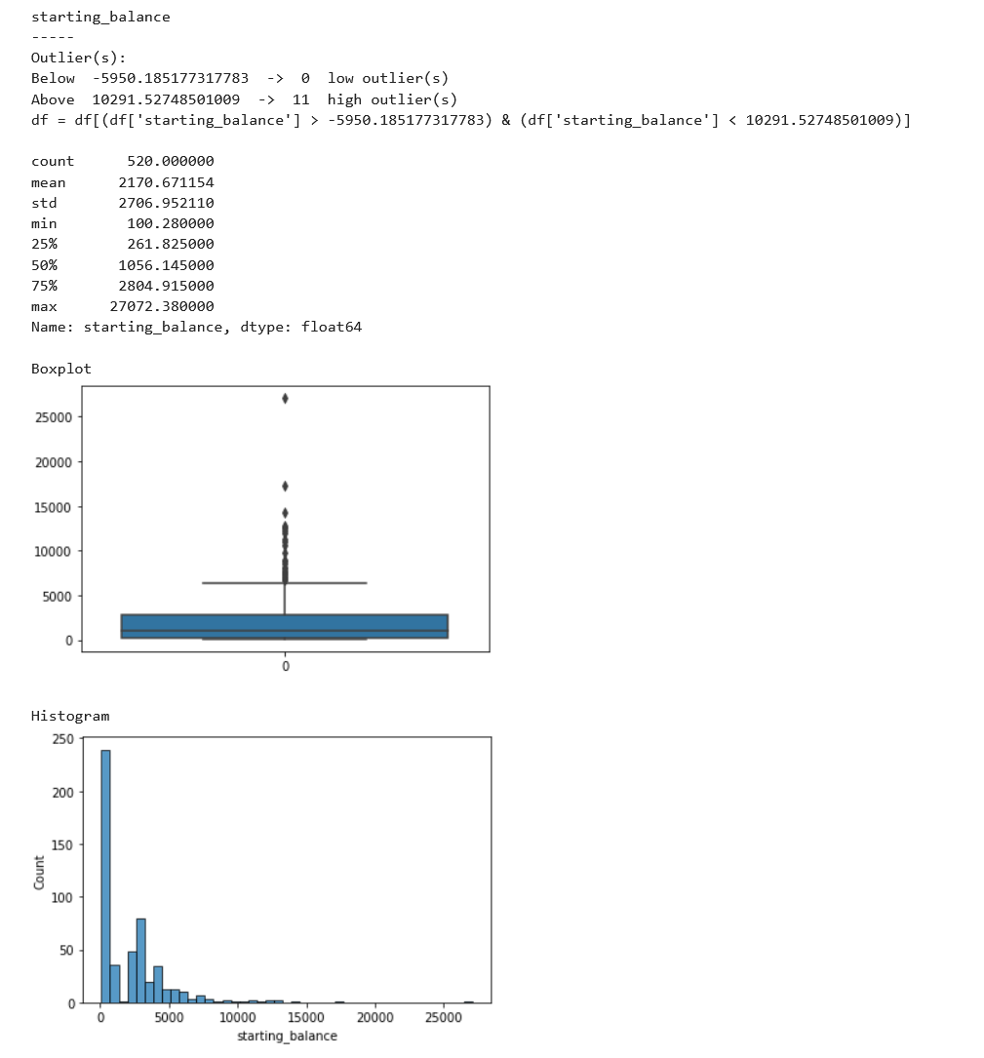
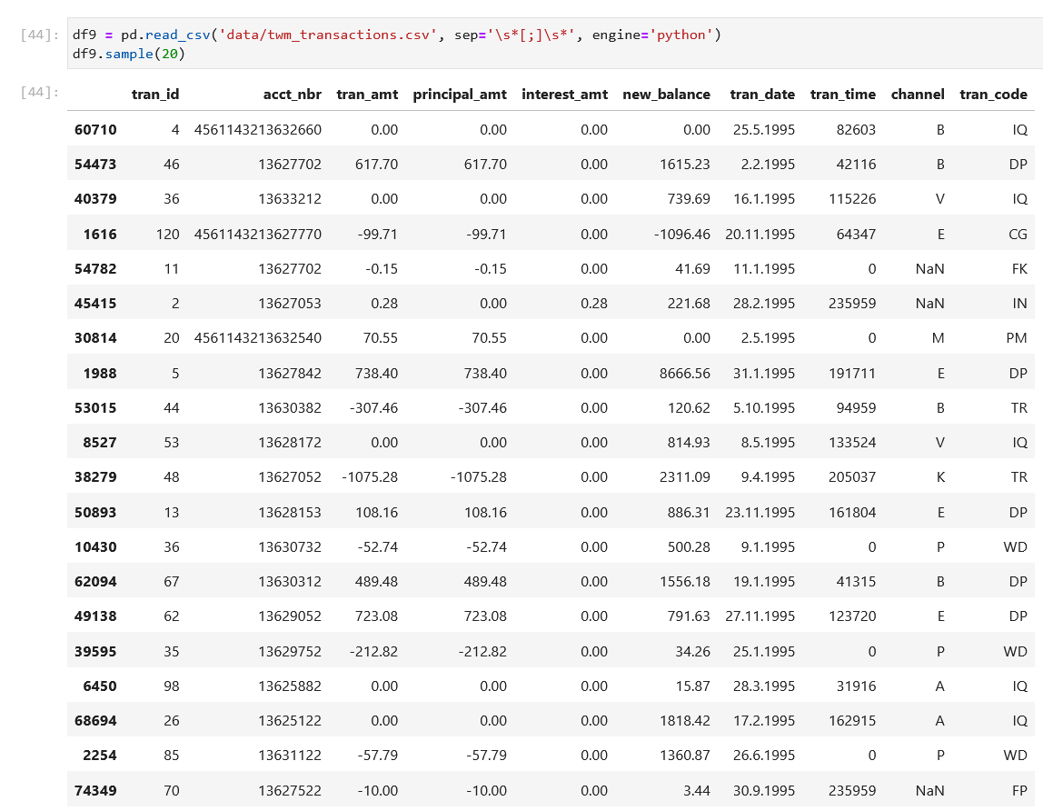
Preparation | Data Cleaning
5
4
1
2
1995-05-25
23:59:59
3
Notes:
format acct_nbr
Format date
Format time
Remove Outliers
5. Removing space before and after separator

Slide 5
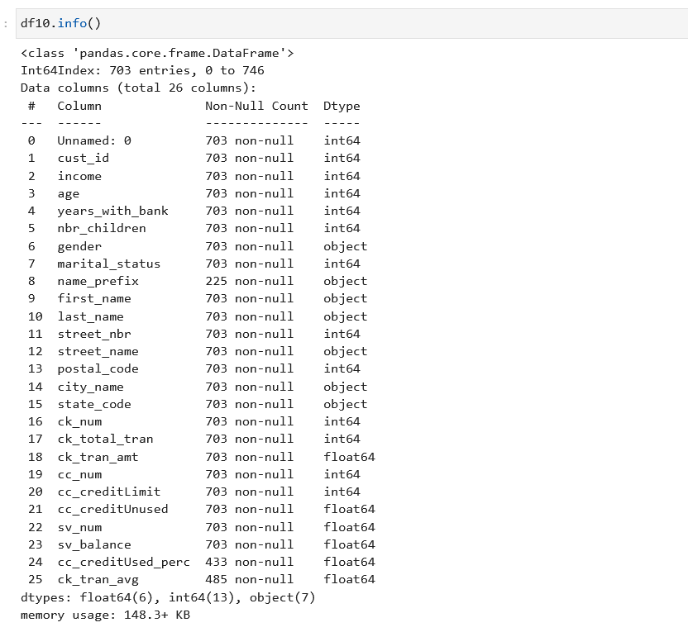
Preparation | New Columns
New columns to quantify banking behavior:
Chose columns for demographics
Dropped the other columns
ck_num | Number of chequing account a customer has
ck_total_tran | Total number of transactions made by a customer with his chequing account(s)
ck_tran_amt | Sum of all transactions made by a customer with his chequing account(s)
cc_num | Number of Credit Card a customer has
cc_creditLimit | Total amount of Credit a customer has
cc_creditUnused | Amount of credit a customer has NOT used
sv_num | Number of savings account a customer has
sv_balance | Amount of savings a customer has
cc_creditUsed_perc | How much of his credit (%) a customer used
ck_tran_avg | Average amount ($) per transaction a customer makes with his chequing account(s)
Demographics
Banking behavior

Slide 6
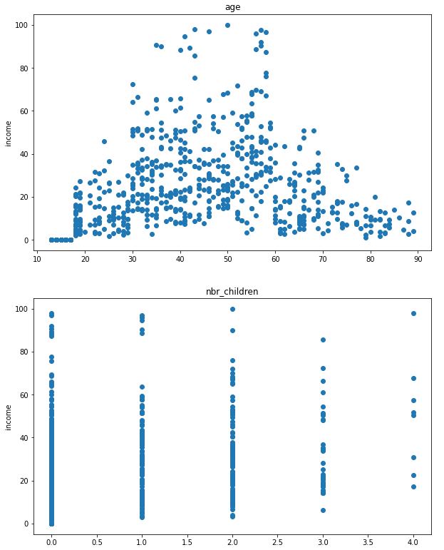
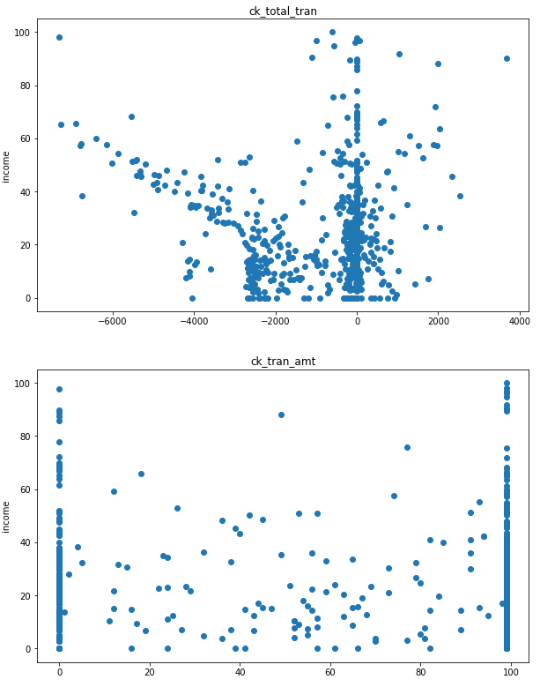
Preparation | Variable Correlation Scatter Plots
Income and Age
Income and Total Transaction
(CHQ)
ck_num | Number of chequing account a customer has
ck_total_tran | Total number of transactions made by a customer with his chequing account(s)
ck_tran_amt | Sum of all transactions made by a customer with his chequing account(s)
cc_num | Number of Credit Card a customer has
cc_creditLimit | Total amount of Credit a customer has
cc_creditUnused | Amount of credit a customer has NOT used
sn_num | Number of savings account a customer has
sv_balance | Amount of savings a customer has
cc_creditUsed_perc | How much of his credit (%) a customer used
ck_tran_avg | Average amount ($) per transaction a customer makes with his chequing account(s)
Income and No. of Children
Income and Transaction Amount (CHQ)
Notes:
What we did after is visualize every value in a scatterplot to orient ourselves to what the data was.
We used income as our y axis as we decided to do our model around trying to predict the income of the customer based on their banking behaviours and/or their other demographics.
We started with 13x different variables and at this stage dropped 6x:
ck_num
Cc_num
Sv_num
Credit_used_perc
Ck_tran_avg
Years_with_bank -> did we forget it?

Slide 7
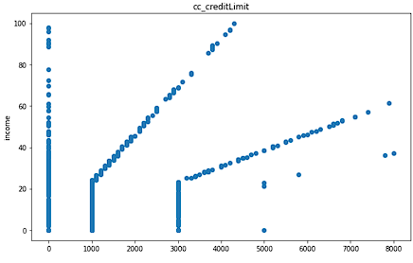
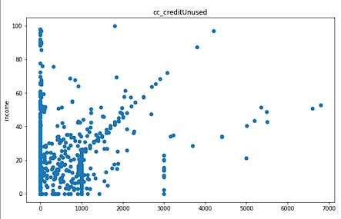
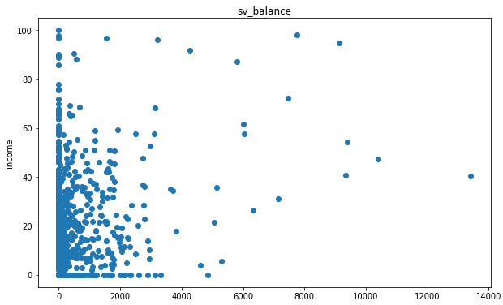
Preparation | Variable Correlation Scatter Plots
4x different clusters:
No credit
Starting Credit = 1000 & increase based on revenue over ~20K
Starting Credit = 3000 & increase based on revenue over ~20K
Starting Credit = 5000 & increase based on revenue over ~20K
Likely another causal factor. Did not further investigate as outside the scope of this project.
Income and Credit Limit
Income and Unused Credit
Income and Savings Balance
Notes:
Function that visualizes relationships between variables

Slide 8
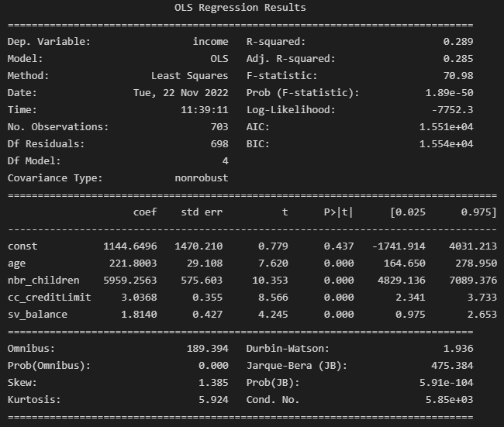
Preparation | Ordinary Least Squares
R-squared: 29% reflects a weak relationship between the dependent and independent variables
Features with high p-values (>0.05) were dropped
p-values: features have very strong significance
Notes:
ck_total_tran', 'ck_tran_amt', 'cc_creditUnused’
these three were dropped with OLS – p-values < 0.05
3. r-squared low, 0.289
4. The variables that are still shown, display p-values of 0.00, this is most likely due to the fact that p-values are less than 3 decimal places, and not shown on the model results

Slide 9
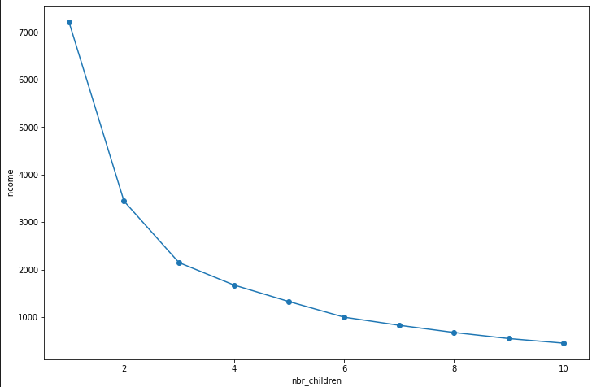
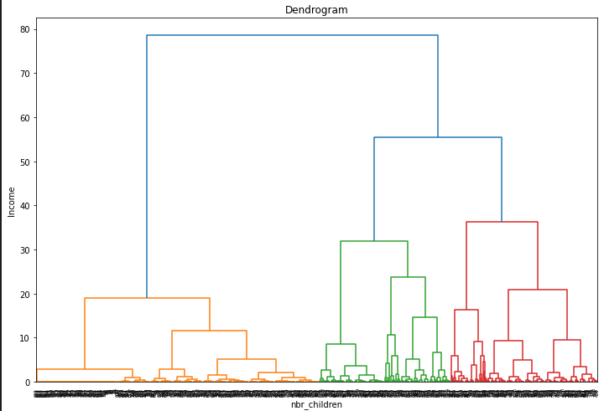
Results | Clustering Methodology: Determining Clusters
K-Means (Elbow Plot)
Hierarchical (Dendrogram)
Clusters = 4
K = 3
Notes:
*When we arrived to the clustering part of this project, we had 4x values left:
Demographics:
Age
Nbr_Children
Banking Behavior:
Credit Limit
Balance in savings
We started by using the elbow method and the dendrogram method to identify the recommended number of cluster for each.
=====
Elbow plot
In cluster analysis, the elbow method is a heuristic used in determining the number of clusters in a data set. The method consists of plotting the explained variation as a function of the number of clusters and picking the elbow of the curve as the number of clusters to use
Dendrogram
The key to interpreting a dendrogram is to focus on the height at which any two objects are joined together. Observations are allocated to clusters by drawing a horizontal line through the dendrogram. Observations that are joined together below the line are in clusters

Slide 10
Segmentation 1: Demographics

Slide 11
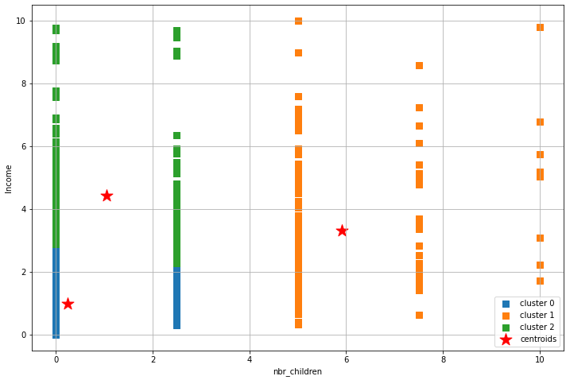
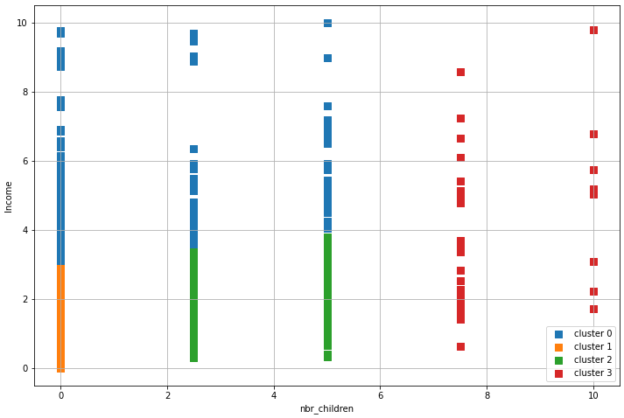
Clustering | Demographics (Income and Number of Children)
K-Means – 3 Clusters
Hierarchical – 4 Clusters
Notes:
Cluster of Income & Number of children. In our opinion, neither K-means and hierarchical performed well

Slide 12
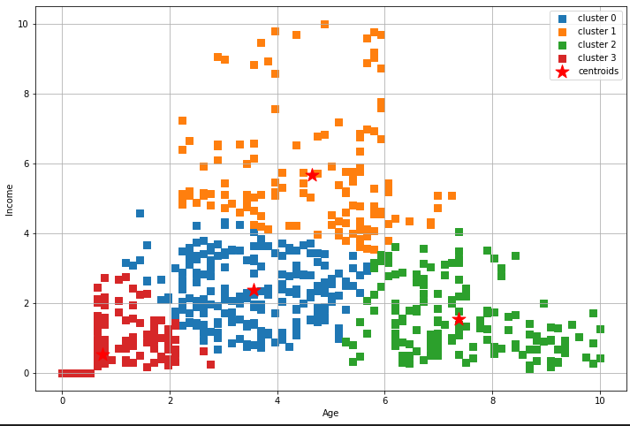
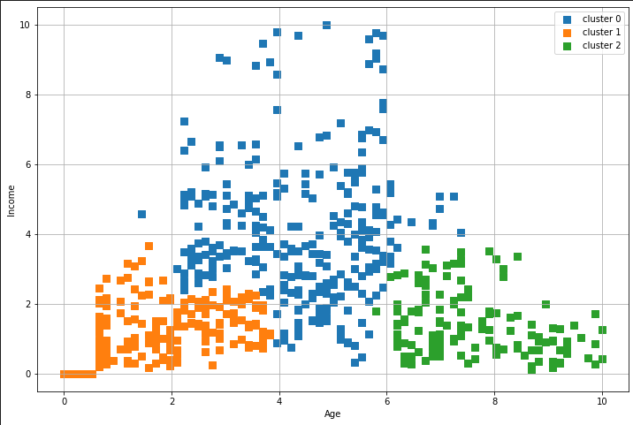

Clustering | Demographics (Income and Age)
K-Means – 4 Clusters
Hierarchical – 3 Clusters
Notes:
Income and age. We preferred the K-means for this one and these are the demographic segmentations we used for the rest of this project.

Slide 13
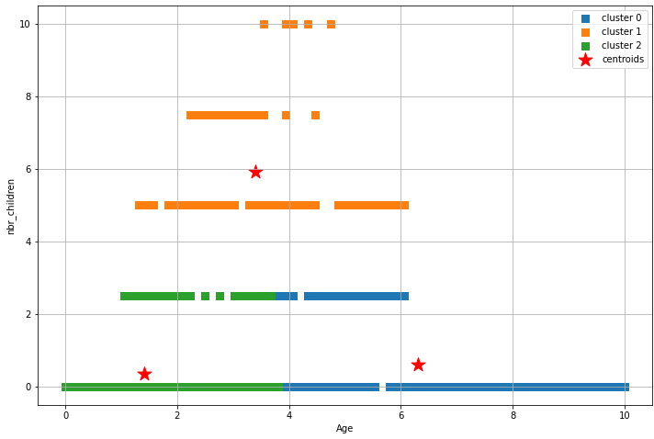
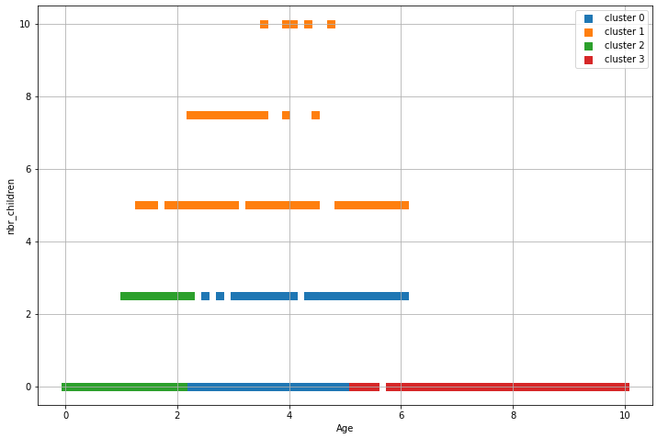
Clustering |Demographics (Age and Number of Children)
K-Means – 3 Clusters
Hierarchical – 4 Clusters
Notes:
In our opinion, neither K-means and hierarchical performed well

Slide 14
Segmentation 2: Banking Behavior

Slide 15
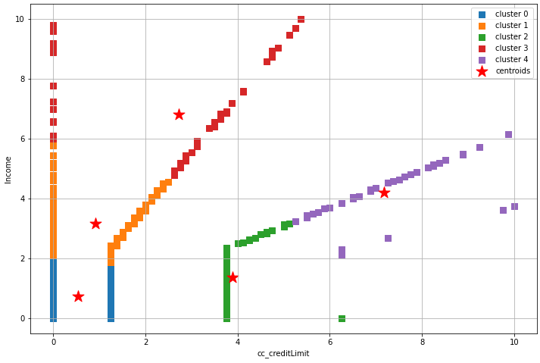
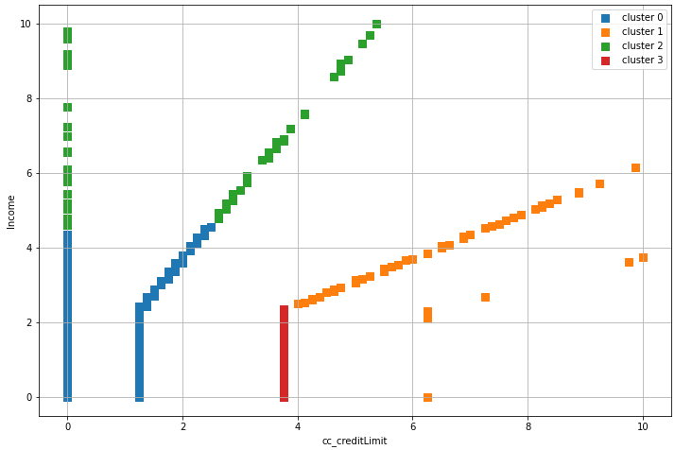
Clustering | Banking Behavior (Income and Credit Balance)
K-Means – 5 Clusters
Hierarchical – 4 Clusters
Notes:
This is the one Sebastien was talking earlier. As you can see, although we can see 5/4 different clusters, neither K-means nor hierarchical performed well for this one.

Slide 16
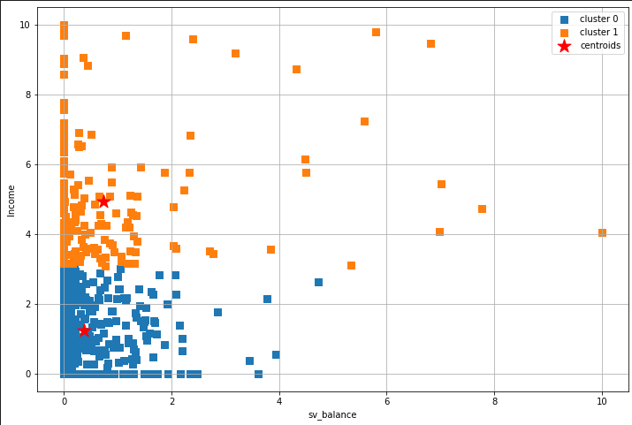
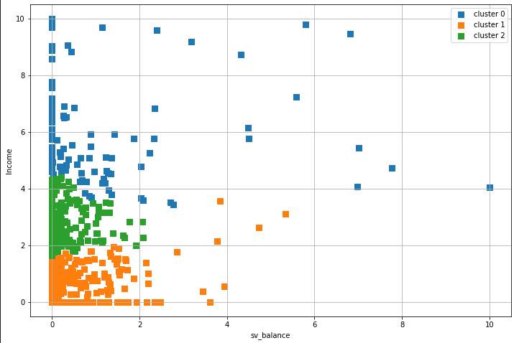
Clustering | Banking Behavior (Income and Savings Balance)
K-Means – 2 Clusters
Hierarchical – 3 Clusters
Notes:
In our opinion, hierarchical performed better, and this is the segmentations we used for banking behaviors for the rest of this project

Slide 17
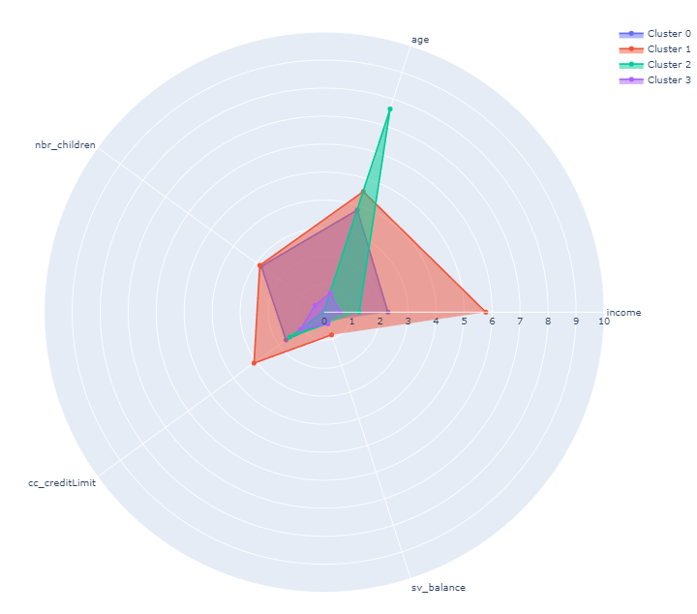
Radar Chart | Demographics
Age and Income
Cluster 0 – Average working class
Cluster 1 – Significantly higher income, slightly older than average, average number of children, more credit and savings
Cluster 2 – Significantly older, less income, less savings, no children
Cluster 3 – Significantly younger, little to no income, savings, credit and children
Notes:
This is the Radar chart for demographics.
This chart is displaying the average value of each customer that fall into the clusters we chose. Values on the radar plot are scaled 0 to 10.
-Theory to explain why older people have no kids -> children considered adults once they reach 18+, meaning their parents no longer have any dependents (assumption)

Slide 18
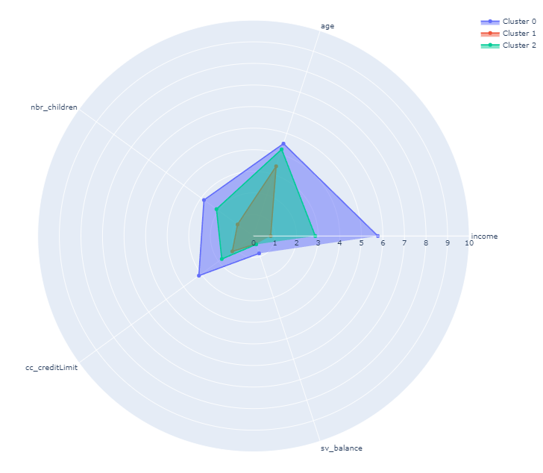
Radar Chart | Banking Behavior
Income and Savings Balance
Cluster 0 – Medium to high income, with low to high savings, have more children, more credit, and older in age
Cluster 1 – Low to medium income, with low to medium savings, have less children, least credit, and are younger in age
Cluster 2 – Very low income, with very low savings, have children, medium credit, and are older in age
Notes:
This is the Radar chart for banking behavior, regarding income and savings balance.
This chart is displaying the average features we chose for each customer that falls into the clusters discovered.

Slide 19
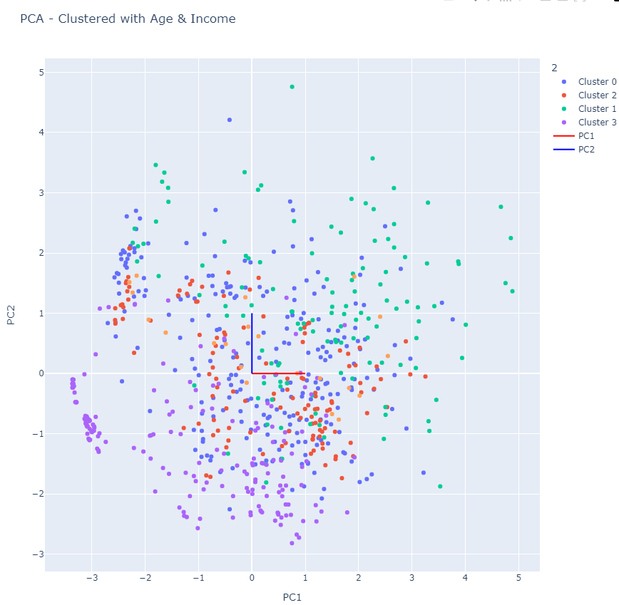
PCA | 2D Biplot
Age and Income
Notes:
Using PCA, we simplified our model to two dimensions and so we graph it onto a 2D biplot. Here you can see the plot and how it divides the demographics segmentations (the colours of the points)

Slide 20
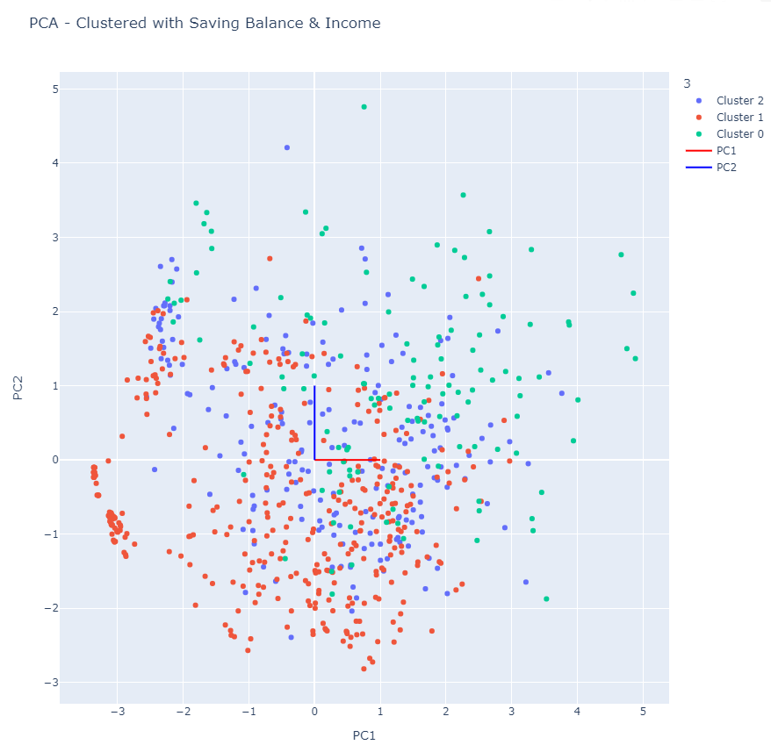
PCA | 2D Biplot
Savings Balance and Income
Notes:
Here you can see the same biplot and how it divides the banking behaviours segmentations (the colours of the points)

Slide 21
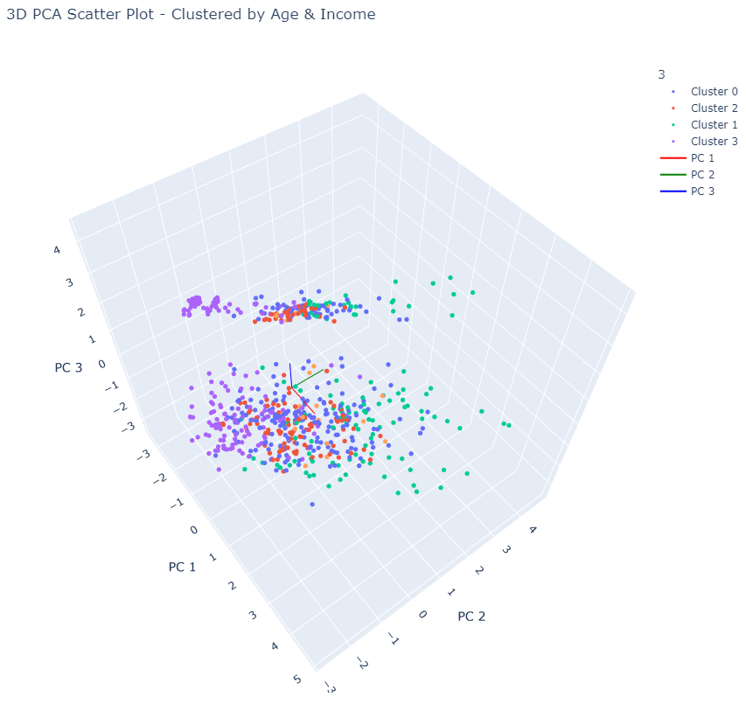
PCA | 3D Biplot
Age and Income
Notes:
We also ran a PCA to have three dimensions a do a nice 3D biplot. Here you can see the scatter plot and how it divides the demographics segmentations (the colours of the points)

Slide 22
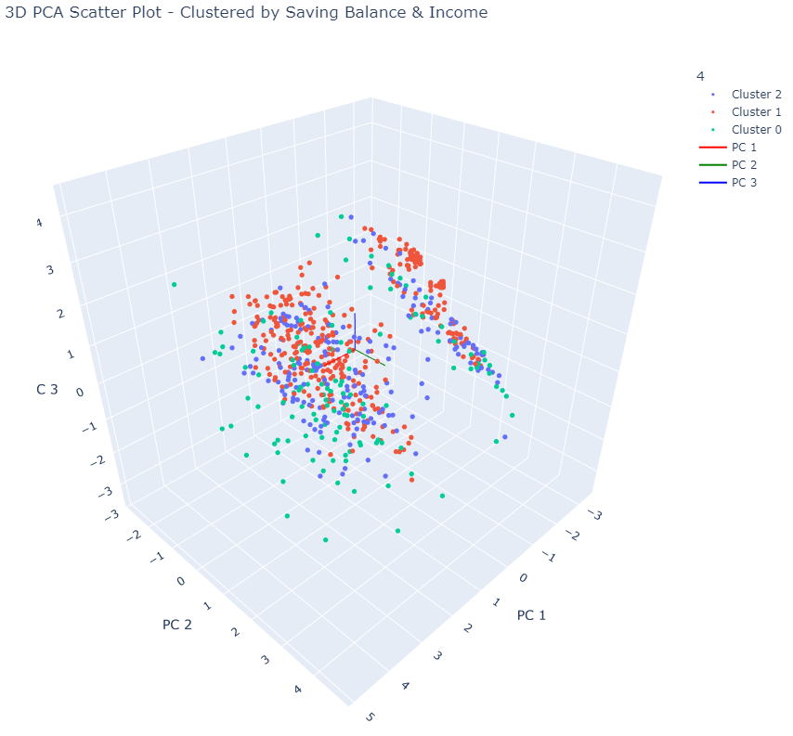
PCA | 3D Biplot
Savings Balance and Income
Notes:
Here you can see the same biplot (screenshot was taken at a different angle) and how it divides the banking behaviours segmentations (the colours of the points)

Slide 23
Challenges
Data Cleaning
Cleaning through several large datasets
Having to deal with duplicate or missing values
Reformatting strings in the form of integers to datetime (0 to 0:00:00)
Dealing with whitespaces in .csv files, meaning .csv’s had multiple delimiters to separate by
PCA Process
Deploying PCA uncovered many complexities, including creating an efficient function to output our required biplots
There were many nuances such as ensuring we understood what our scree plots, and loading values were outputting
Adding the filter cluster colours to the biplots

Slide 24
Questions?

Slide 25
Thank You For
Listening!

